Slide 1
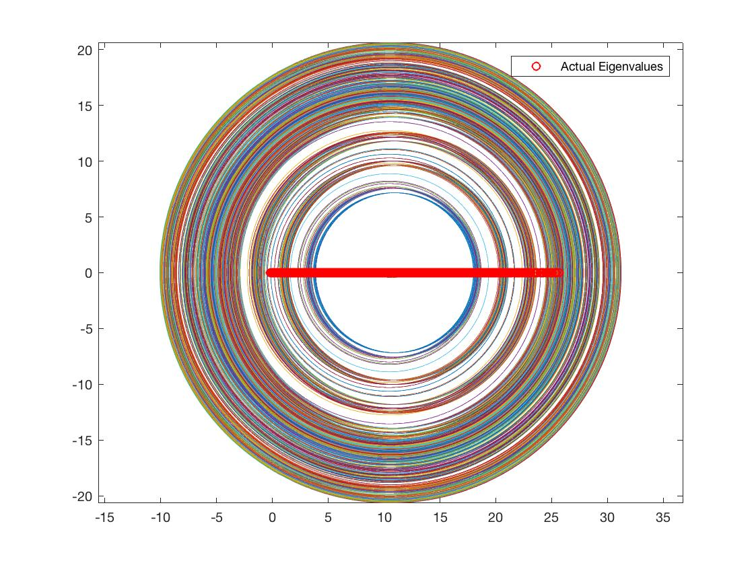
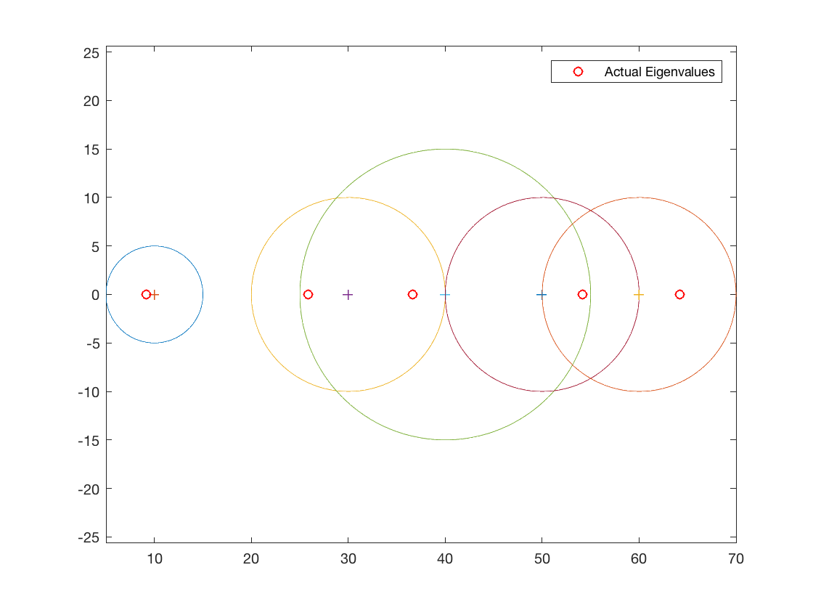
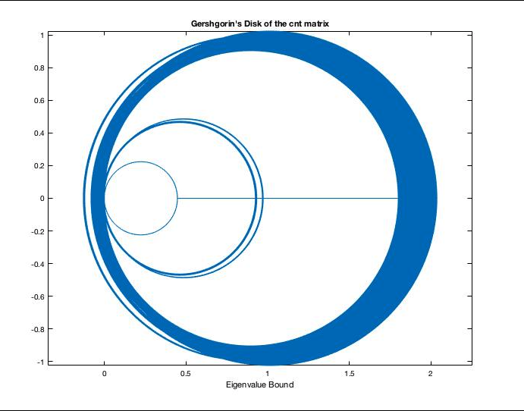
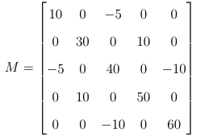































































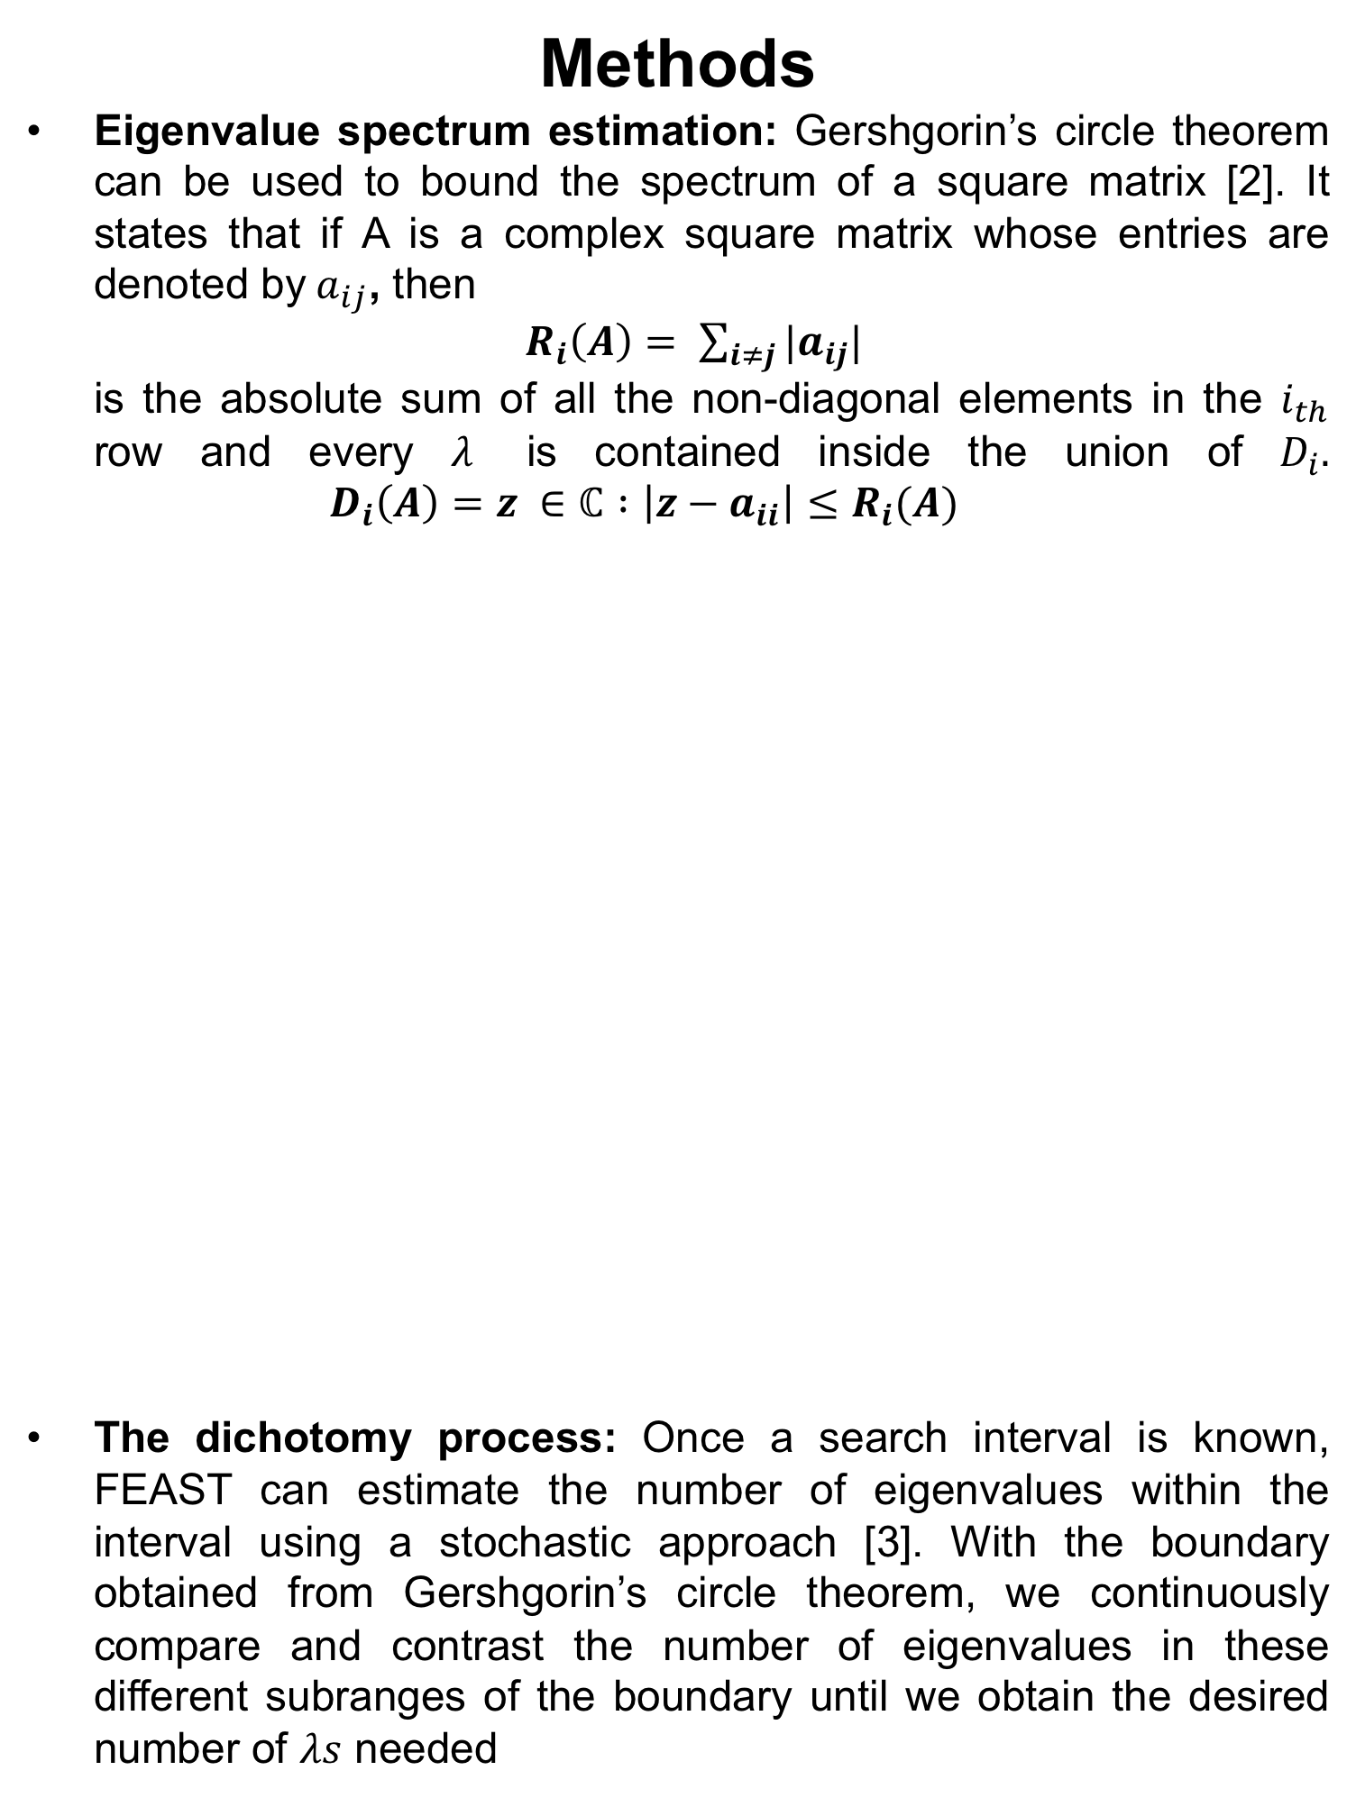













































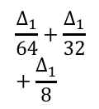






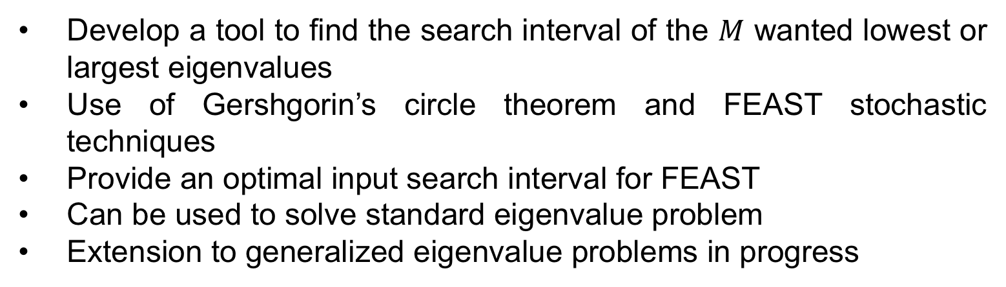

Extreme Eigenvalue Calculations
Through the FEAST Framework
Ayodeji Marquis
Faculty Advisor: Professor Eric Polizzi (ECE)
Abstract
The eigenvalue problem, $Ax=$𝜆x, is ubiquitous in Science and Engineering. Many numerical tools have been developed over the years to compute eigenvalues and eigenvectors. The FEAST eigenvalue solver belongs to a new generation of techniques that are ideally suited for large-scale parallel computing. FEAST requires the user to specify a search interval in the eigenvalue spectrum which may be difficult to know a priori for computing the extreme eigenvalues. This project proposes a tool for computing the search interval of $M$ extreme lowest or largest eigenvalues. We employ procedures such as Gershgorin’s circle theorem and FEAST stochastic techniques in our approach. The resulting search interval which is obtained at a relatively low cost can be used as an input for FEAST.
$$n=120>N=50$$
$$n=120>N=50$$
$$A_{0}$$
$$A_{1}$$
$$\frac{∆_{1}}{8}$$
$$\frac{∆_{1}}{16}$$
$$B_{1}$$
$$B_{0}$$
$$B_{0}$$
$$B_{1}$$
$$\frac{∆_{1}}{8}$$
$$\frac{∆_{1}}{16}$$
$$A_{1}$$
$$A_{0}$$
$$n=55>N=50$$
$$n=55>N=50$$
$$A_{0}$$
$$A_{1}$$
$$\frac{∆_{1}}{8}$$
$$\frac{∆_{1}}{32}$$
$$B_{1}$$
$$B_{0}$$
$$B_{0}$$
$$B_{1}$$
$$\frac{∆_{1}}{8}$$
$$\frac{∆_{1}}{32}$$
$$A_{1}$$
$$A_{0}$$
Results
We aim to find at least 50 and at most 100 extreme eigenvalues either near the minimum or the maximum the following matrices:
Na5: It’s a real symmetric matrix of size $5832 × 5832$
  Using Dichotomy
Cnt_A: It’s a real symmetric matrix of size $12450 × 12450$
Introduction
FEAST is a high-performance eigensolver package for solving the Hermitian and non-Hermitian eigenvalue problems, and obtaining all the eigenvalues and (right/left) eigenvectors within a given search interval or arbitrary domain in the complex plane [1]
This project aims to provide a tool to find the extreme lowest or largest eigenvalues that best describes the system, and meets the user’s requirements without having them to specify a search interval
$$−10.1$$
$$\frac{∆_{0}}{8}$$
$$−4.9$$
$$m=0$$
$$31.2$$
$$−10.1$$
$$−4.9$$
$$\frac{∆_{1}}{8}$$
$$−0.4$$
$$∆_{1}$$
$$31.2$$
$$m=0<50$$
$$−10.1$$
$$−0.4$$
$$\frac{∆_{2}}{8}$$
$$3.5$$
$$∆_{2}$$
$$31.2$$
$$100<m=468$$
Methods
Eigenvalue spectrum estimation: Gershgorin’s circle theorem can be used to bound the spectrum of a square matrix [2]. It states that if A is a complex square matrix whose entries are denoted by$a_{ij}$, then $R_{i}\left(A\right)= \sum_{i≠j}{|a_{ij}|}$
is the absolute sum of all the non-diagonal elements in the $i_{th}$ row and every $λ$ is contained inside the union of $D_{i}.$
$D_{i}\left(A\right)=z ∈ℂ :\left|z−a_{ii}\right|≤R_{i}(A)$
The dichotomy process: Once a search interval is known, FEAST can estimate the number of eigenvalues within the interval using a stochastic approach [3]. With the boundary obtained from Gershgorin’s circle theorem, we continuously compare and contrast the number of eigenvalues in these different subranges of the boundary until we obtain the desired number of $λs$ needed
Gershgorin’s discs of Na5
The eigenvalue bound is [-10.1, 31.2]
$$−10.1$$
$$−0.4$$
$$\frac{∆_{2}}{16}$$
$$1.0$$
$$∆_{2}$$
$$31.2$$
$$50<m=74<100$$
$$2.04$$
$$\frac{∆_{0}}{8}$$
$$m=0$$
$$1.77$$
$$−0.13$$
$$2.04$$
$$1.77$$
$$\frac{∆_{1}}{8}$$
$$1.53$$
$$∆_{1}$$
$$−0.13$$
$$m=2<50$$
$$2.04$$
$$1.77$$
$$\frac{∆_{1}}{8}$$
$$1.53$$
$$\frac{∆_{1}}{16}$$
$$−0.13$$
$$100<m=510$$
$$2.04$$
$$1.77$$
$$\frac{∆_{1}}{32}+\frac{Δ_{1}}{8}$$
$1.4$6
$$−0.13$$
Gershgorin’s discs of cnt
The eigenvalue bound is [-0.13, 2.04]
$$m=17<50$$
Gershgorin’s discs of Matrix M
The eigenvalue bound is [5,70]
$$2.04$$
$$1.77$$
$$\frac{∆_{1}}{64}+\frac{Δ_{1}}{32}+\frac{Δ_{1}}{8}$$
$$1.43$$
$$−0.13$$
$$100<m=153$$
$$1.77$$
$$1.44$$
$$2.04$$
$$\frac{∆_{1}}{64}+\frac{Δ_{1}}{32}+\frac{Δ_{1}}{8}−\frac{Δ_{1}}{128}$$
$$50<m=56<100$$
$$−0.13$$
Summary and Conclusion
Minimum extreme
Maximum extreme
Develop a tool to find the search interval of the $M$ wanted lowest or largest eigenvalues
Use of Gershgorin’s circle theorem and FEAST stochastic techniques
Provide an optimal input search interval for FEAST
Can be used to solve standard eigenvalue problem
Extension to generalized eigenvalue problems in progress
$$∆_{0}$$
$$∆_{0}$$
$$A_{0}$$
$$m=0$$
$$B_{0}$$
$$A_{0}$$
$$m=0$$
$$B_{0}$$
$$A_{0}$$
$$\frac{∆_{0}}{8}$$
$$B_{1}$$
m$=15<M=50$
$$B_{0}$$
$$B_{0}$$
$$\frac{∆_{0}}{8}$$
$$A_{1}$$
$$m=15<M=50$$
$$A_{0}$$
References
$$\frac{∆_{1}}{8}$$
$$∆_{1}$$
$$\frac{∆_{1}}{8}$$
$$∆_{1}$$
[1] Polizzi, E. "FEAST Eigenvalue Solver.", http://www.feast-solver.org/
[2] Gerschgorin, S. "Über die Abgrenzung der Eigenwerte einer Matrix”, (1931)
[3] Di Napoli E., Polizzi E., Saad Y. “Efficient estimation of eigenvalue counts in an interval”, NLAA , v23, p674 (2016)
$$A_{0}$$
$$A_{1}$$
$$B_{1}$$
$$B_{0}$$
$$B_{0}$$
$$B_{1}$$
$$A_{1}$$
$$A_{0}$$
Department of Electrical and Computer Engineering
2018 ECE Honors Exhibition
College of Engineering - University of Massachusetts Amherst

